Slide 1
CHAPTER 2 ASSET ALLOCATION
Dr. Le Quy Duong
Email: duonglq@neu.edu.vn
Phone: 0966973642

Slide 2
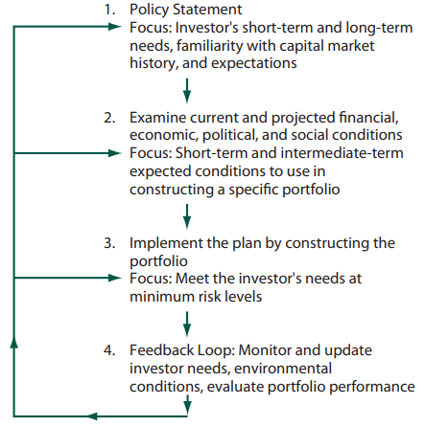
PORTFOLIO MANAGEMENT PROCESS

Slide 3
PORTFOLIO MANAGEMENT PROCESS
A policy statement specifies the types of risks the investor is willing to take and his or her investment goals and constraints.
All investment decisions should be consistent with the policy statement to ensure that these decisions are appropriate for the investor.
Because investor needs, goals, and constraints change over time, the policy statement must be periodically reviewed and updated

Slide 4
THE NEED FOR A POLICY STATEMENT
Understanding and Articulating Realistic Investor Goals.
Standards for Evaluating Portfolio Performance.
Protects the client against a portfolio manager’s inappropriate investments or unethical behavior

Slide 5
ASSET ALLOCATION
Asset allocation is the process of deciding how to distribute an investor’s wealth among different countries and asset classes for investment purposes. The asset allocation decision involves the following points
What asset classes should be considered for investment?
What policy weights should be assigned to each eligible asset class?
What are the allowable allocation ranges based on policy weights?

Slide 6
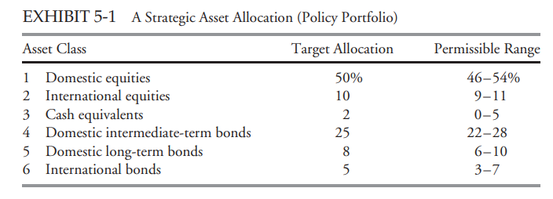
ASSET ALLOCATION

Slide 7
ASSET CLASSES
An asset class is comprised of securities that have similar characteristics, attributes, and risk/return relationships. A broad asset class, such as “bonds,” can be divided into smaller asset classes, such as treasury bonds, corporate bonds, and high-yield bonds.

Slide 8
ASSET CLASSES
Assets within an asset class should be relatively homogeneous. Assets within an asset class should have similar attributes
Asset classes should be mutually exclusive. Overlapping asset classes will reduce the effectiveness of strategic asset allocation in controlling risk and also introduce problems in developing asset-class return expectations.
Asset classes should be diversifying. For risk-control purposes, an included asset class should not have extremely high expected correlations with other asset classes or with a linear combination of the other asset classes. A pairwise correlation above 0.95 is undesirable

Slide 9
ASSET CLASSES
The asset classes as a group should make up a preponderance of world investable wealth. Including more markets expands the opportunities for applying active investment strategies, reducing market risks.
The asset class should have the capacity to absorb a significant fraction of the investor’s portfolio without seriously affecting the portfolio’s liquidity. Practically, most investors will want to be able to reset or rebalance to a strategic asset allocation without moving asset-class prices or incurring high transaction costs

Slide 10
ASSET CLASSES
International fixed income
Domestic common equity
Domestic fixed income
International common equity
Cash and cash equivalents
Real estate, private equity,
Natural resources, commodities

Slide 11
RISK AND RETURN OBJECTIVES
Return Objectives:
Provide an adequate retirement income (for an individual currently in the workforce).
Maintain a fund’s real purchasing power after distributions
Adequately fund liabilities (for insurance companies, banks, etc).
Exceed the rate of inflation in the long term

Slide 12
RISK AND RETURN OBJECTIVES
Risk Objectives:
To apply a quantitative approach to asset allocation, however, we must quantify an investor’s attitude to risk
The most precise way to do so is to measure the investor’s numerical risk aversion: R_{A}
Numerical risk aversion can be measured in an interview or questionnaire in which the investor expresses preferences among sets of choices involving risky and certain returns
An R_{A} of 6 to 8 represents a high degree of risk aversion (a low risk tolerance), while an R_{A} of 1 to 2 represents a relatively low degree of risk aversion (a high risk tolerance)

Slide 13
RISK AND RETURN OBJECTIVES
Risk Objectives: Investor’s expected utility
U_{P} = E(R_{P}) – 0.005 R_{A}σ²_{p}
Where:
U_{m}: the investor’s expected utility for portfolio P
E(R_{P}): expected return for portfolio P
R_{A}: the investor’s risk aversion
σ²_{p}: variance of return for portfolio P

Slide 14
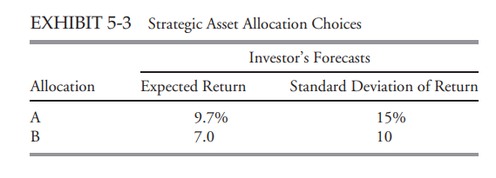
RISK AND RETURN OBJECTIVES
Robert’s risk aversion ($R_{A}$) is 5. Recommend an asset allocation for him

Slide 15
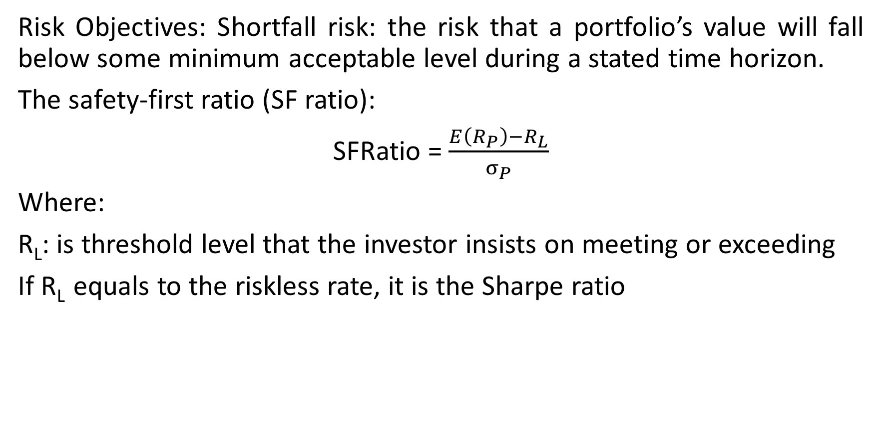
RISK AND RETURN OBJECTIVES
Risk Objectives: Shortfall risk: the risk that a portfolio’s value will fall below some minimum acceptable level during a stated time horizon.
The safety-first ratio (SF ratio):
SFRatio = $\frac{E\left(R_{P}\right)−R_{L}}{σ_{P}}$
Where:
R_{L}: is threshold level that the investor insists on meeting or exceeding
If R_{L} equals to the riskless rate, it is the Sharpe ratio

Slide 16
RISK AND RETURN OBJECTIVES
An investment adviser is counseling Peter, a client who recently inherited $1,200,000 and has above-average risk tolerance (R_{A} = 2). He expects to liquidate $60,000 of the portfolio in 12 months, however, to make the down payment on a house. If that need arises, he states that it is important for him to be able to take out the $60,000 without invading the initial capital of $1,200,000.
Portfolio | Expected return | Standard Deviation of Return
A | 10% | 20%
B | 7% | 10%
C | 5.25% | 5%

Slide 17
RISK AND RETURN OBJECTIVES
Based on the investor’s expected utility, which portfolio should he prefer?
According to the safety-first criterion, which of the three portfolio is the best?
Recommend a strategic asset allocation for Peter.

